Slide 1
Cybersecurity Red-Team Agent with Deep Reinforcement Learning
2025311610 Hoyeon Kim

Slide 2
Cybersecurity Red-Team Agent with Deep Reinforcement Learning
Index
Problem definition
Simulation
Methods
Preliminary results
Discussion and expected results

Slide 3
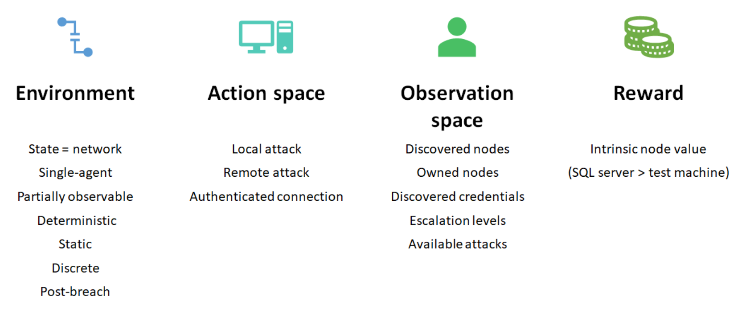
Cybersecurity Red-Team Agent with (Deep) Reinforcement Learning
1. Problem definition
In computer networks, the true security state is hidden.
A red-team agent must use partial observations to choose the next action.
→ POMDP is an appropriate modeling framework.
Notes:
In computer networks, the true security state is hidden.
Then. a red-team agent must use partial observations to choose the next action.
Thus, POMDP is an appropriate modeling framework.

Slide 4
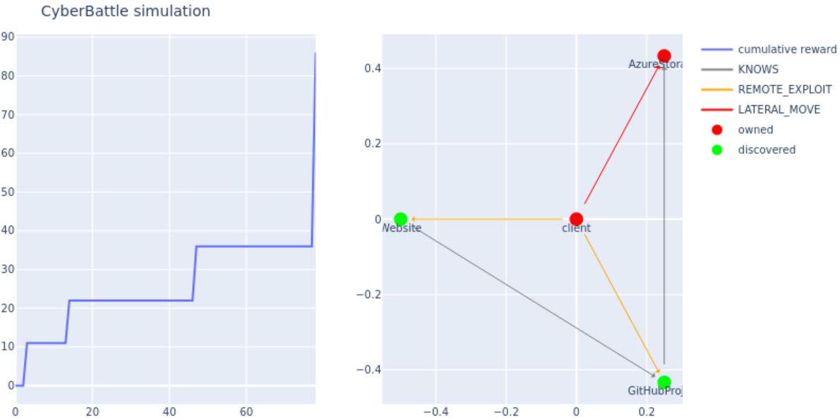
Cybersecurity Red-Team Agent with (Deep) Reinforcement Learning
1. Problem definition
Cybersecurity Red-Team agent decision-making as a POMDP model 𝑀=(𝑆, 𝐴, 𝑇, 𝑅, 𝛺, 𝑂, 𝛾​).
1) Hidden State: Network nodes security states
open ports, unpatched vulnerabilities, credential caches.
2) Actions: Attacker’s behavior
Local Attack, Remote Attack, Authenticated connection
3) Observations: Result of the attacker’s behavior
scan port → open/closed/filtered
exploit → success/failure codes
4) Reward: Value of the attacker’s behavior result
+: security information gain, new node owned/privilege escalation
−: budget usage, exploit detection penalties
Notes:
So, we could model cybersecurity red-team agent decision-making as a POMDP model M.
1) State is network nodes security states
2) Actions are attacker’s behavior
3) Transition & Observations are result of the attacker’s behavior
4) Reward is value of the attacker’s behavior result

Slide 5
Cybersecurity Red-Team Agent with (Deep) Reinforcement Learning
2. Simulation
CyberBattleSim https://github.com/microsoft/CyberBattleSim/tree/main
Network Graph: G(node: machine type, edge: connection protocol)
Vulnerabilities
Simulation does not run any code. Instead, vulnerability is abstractly defining.
Each vulnerability has a pre-defined outcome
A leaked set of credentials.
A leaked reference to another node in the network.
Leaked information about a node (node properties).
Ownerhsip to a node.
Privilege escalation on the node.
Example of remote vulnerabilities
A SharePoint site exposing ssh credentials.
An ssh vulnerability granting access to the machine.
A github project leaking credentials in commit history.
A SharePoint site with file containing SAS token to storage account.
Examples of local vulnerabilities:
Extracting authentication token or credentials from a system cache.
Escalating to SYSTEM privileges.
Escalating to Administrator privileges.
Notes:
I use cyberbattlesim simulator. It contains network graph and vulnerabilities.
Simulation does not run any code. Instead, vulnerability is abstractly defining.

Slide 6
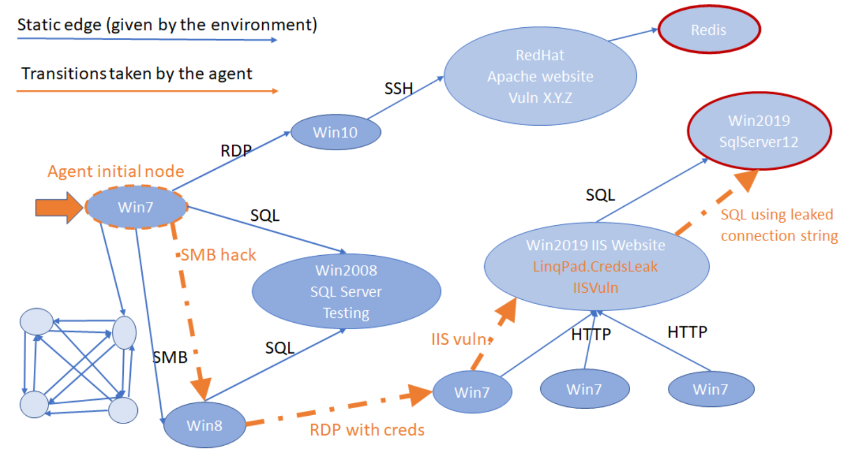
Cybersecurity Red-Team Agent with (Deep) Reinforcement Learning
2. Simulation (Example)
Attacker breaches Win7 node
Then move to the Win8 node by exploiting a vulnerability in SMB
Then move to the Win7 node by using cached credential to log
Then move to IIS server node by exploiting a vulnerability in an IIS remote
Finally get the SQL DB by using leaked connection strings vulnerability in SQL
Notes:
Attacker breaches Win7 node
Then move to the Win8 node by exploiting a vulnerability in SMB
Then move to the Win7 node by using cached credential to log
Then move to IIS server node by exploiting a vulnerability in an IIS remote
Finally get the SQL DB by using leaked connection strings vulnerability in SQL

Slide 7
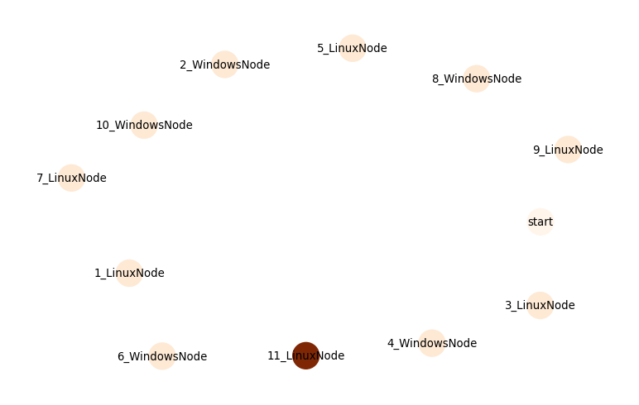
Cybersecurity Red-Team Agent with (Deep) Reinforcement Learning
3. Method
Create a computer network with randomly created 10 nodes (Start = 0, End = 11).
Use 4 types of agents to learn how to exploit the network. - Random - Rule-Based + Random (Repeat Scan → Move → Exploit) - Deep Q-Learning - Q-Tabular Learning
DQL Transfer Learning - Change network node size (4, 20)

Slide 8
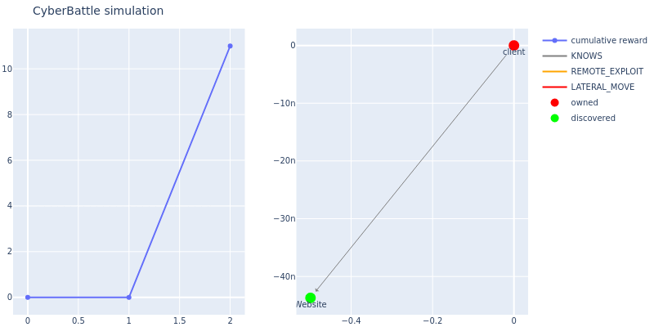
Cybersecurity Red-Team Agent with (Deep) Reinforcement Learning
4. Preliminary results
1) Random: discovered 3 nodes, owned 1 node

Slide 9
Cybersecurity Red-Team Agent with (Deep) Reinforcement Learning
4. Preliminary results
2) Rule-Based + Random (CredentialCacheExploiter): discovered 6 nodes, owned 1 node

Slide 10
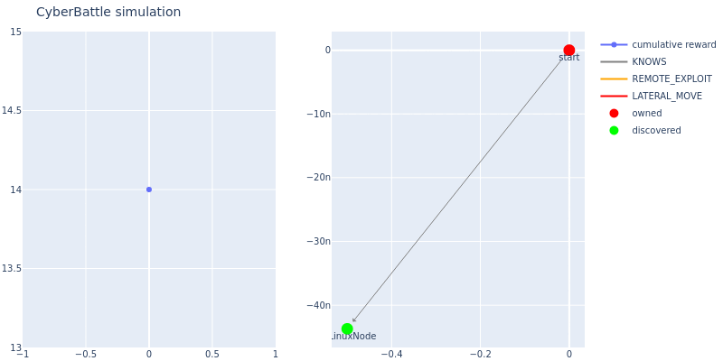
Cybersecurity Red-Team Agent with (Deep) Reinforcement Learning
4. Preliminary results
3) Deep Q-Learning (DQL): discovered 11 nodes, owned 11 nodes

Slide 11
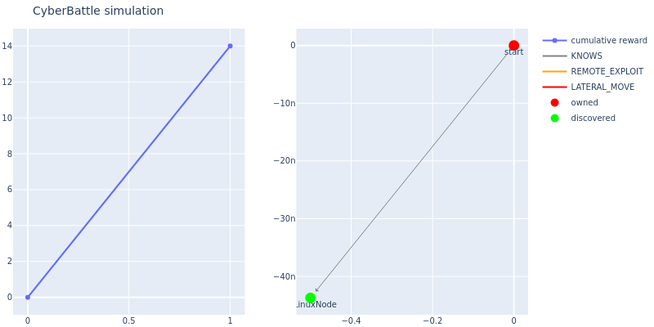
Cybersecurity Red-Team Agent with (Deep) Reinforcement Learning
4. Preliminary results
4) Q-Tabular Learning (QTL): discovered 7 nodes, owned 7 nodes

Slide 12
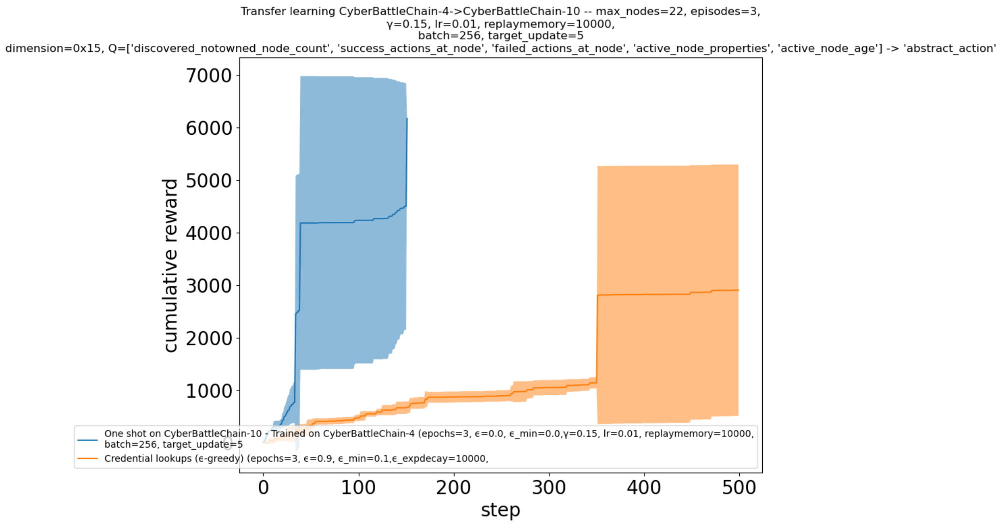
Cybersecurity Red-Team Agent with (Deep) Reinforcement Learning
4. Preliminary results
5) DQL Transfer Learning
4 nodes train, 10 nodes one-shot → Owned all nodes

Slide 13
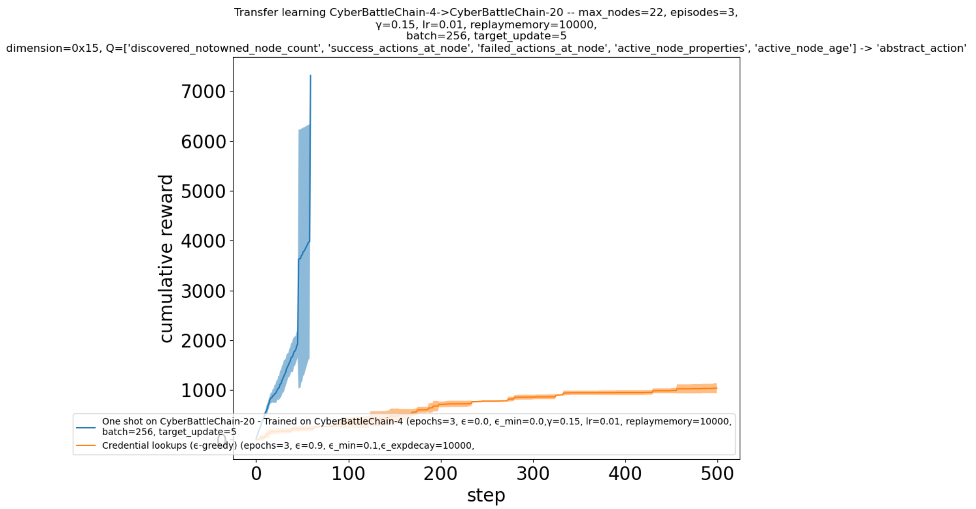
Cybersecurity Red-Team Agent with (Deep) Reinforcement Learning
4. Preliminary results
5) DQL Transfer Learning
4 nodes train, 20 nodes one-shot → Owned all nodes

Slide 14
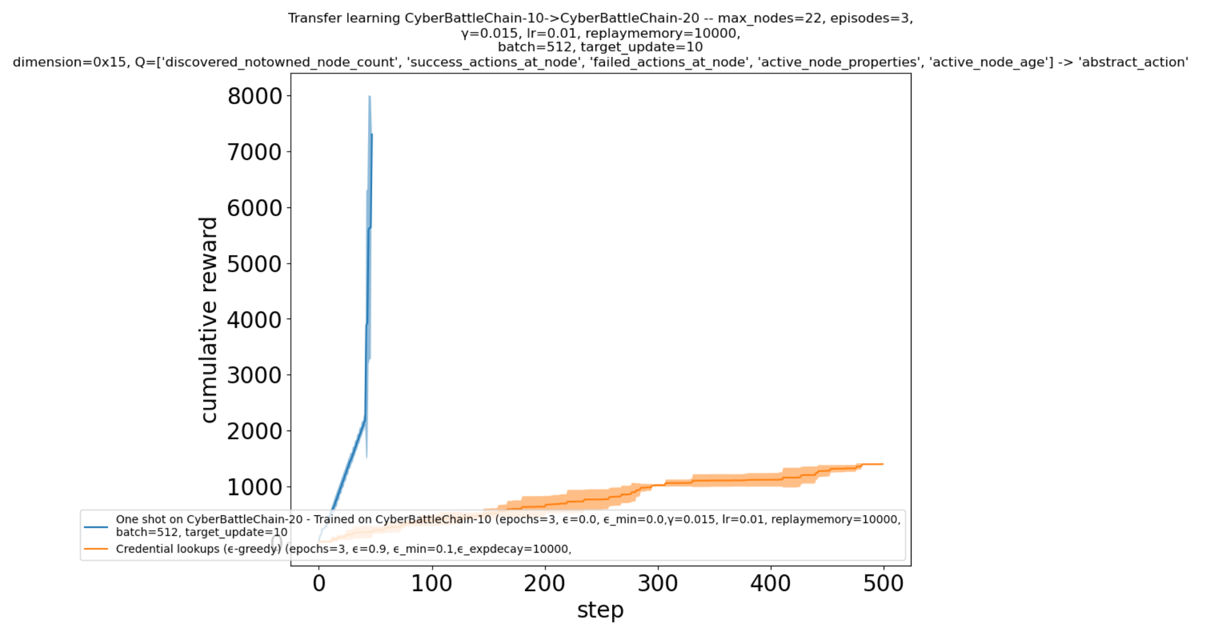
Cybersecurity Red-Team Agent with (Deep) Reinforcement Learning
4. Preliminary results
5) DQL Transfer Learning
10 nodes train, 20 nodes one-shot → Owned all nodes

Slide 15
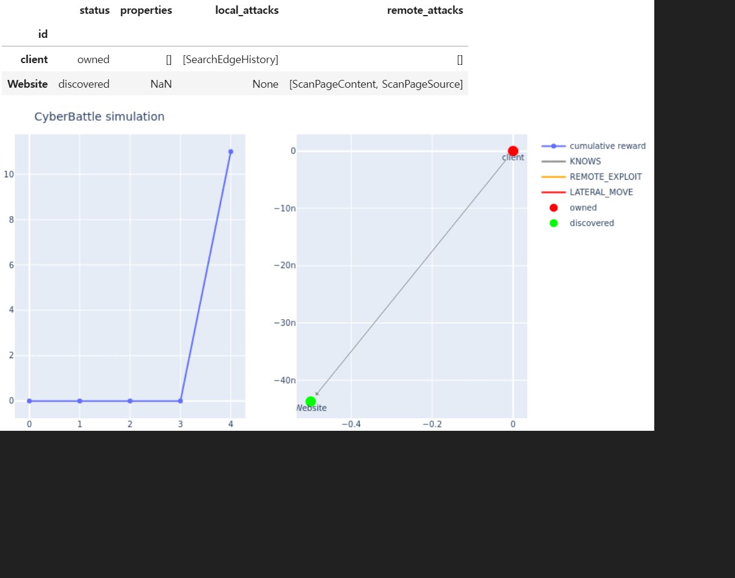
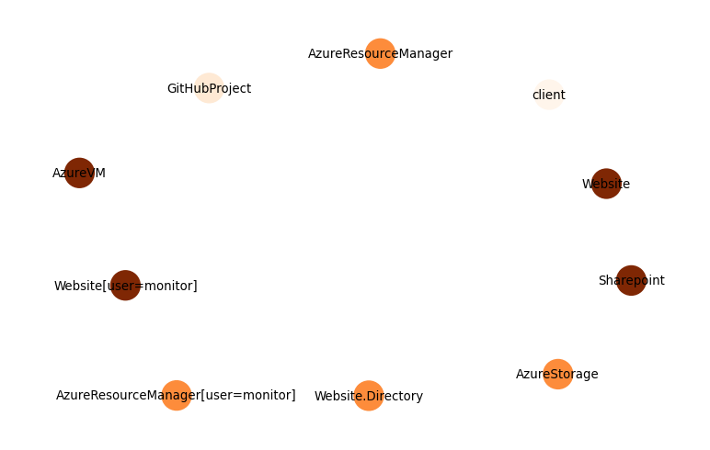
Cybersecurity Red-Team Agent with (Deep) Reinforcement Learning
4. Preliminary results
6) Toy CTF (Capture The Flag)

Slide 16
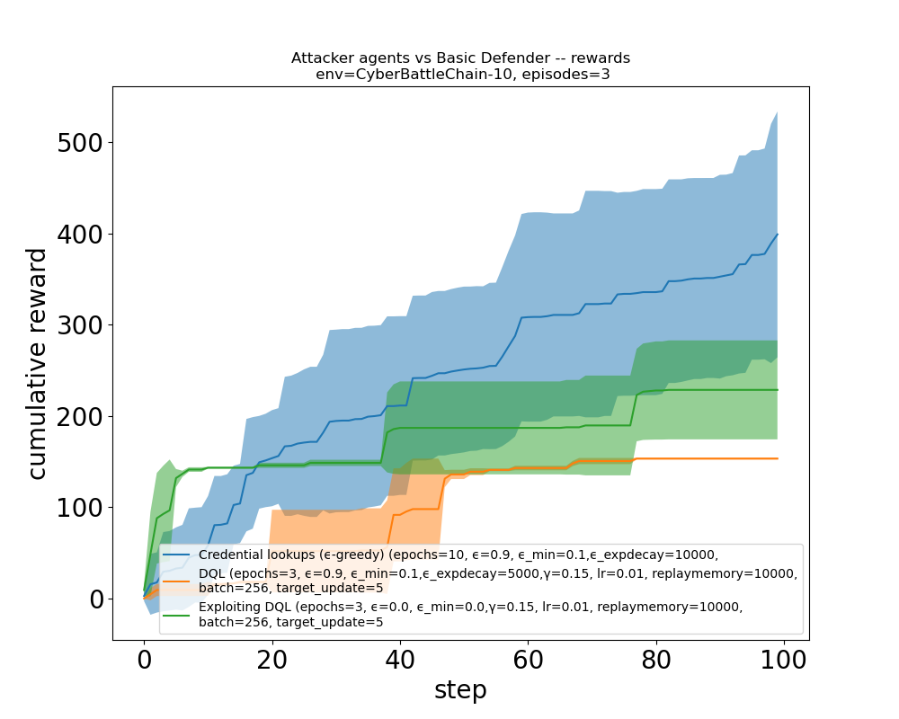
Cybersecurity Red-Team Agent with (Deep) Reinforcement Learning
5. Discussion and expected results
1) Deep Q-Learning is better than Q-Tabular learning.
Because the cybersecurity state model is POMDP.
2) In the attack simulation network, there is no Blue Team.
If add defender, then POMDP Hidden State will changes more dynamically.
Rule-Based (Credential lookups) is better than DQL.
Try DRQN.

Slide 17
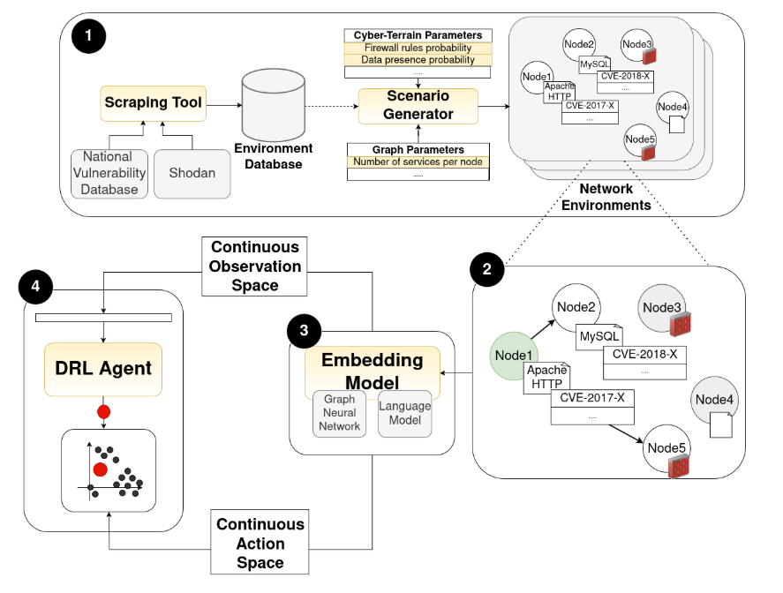
Cybersecurity Red-Team Agent with (Deep) Reinforcement Learning
5. Discussion and expected results
3) Toy CTF is not a real-world attack.
→ There are known attacks in NVD (called CVE).
Try C-CyberbattleSim.
It provides attacks based on CVE.

Slide 18
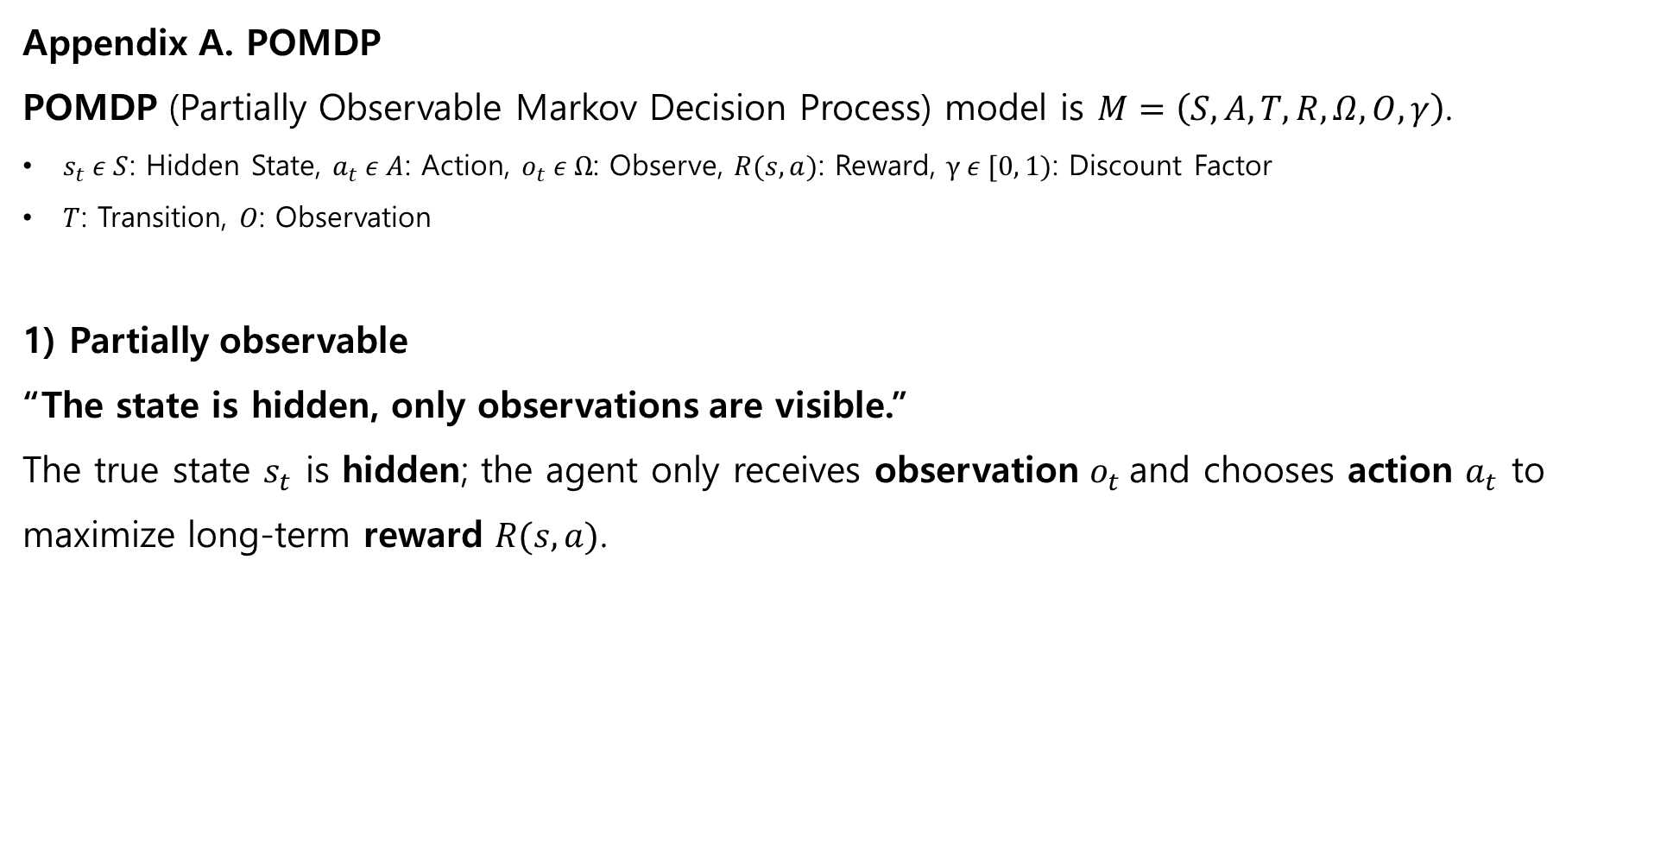
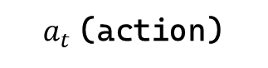
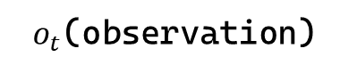
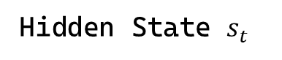
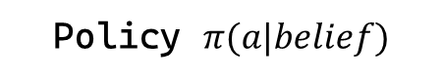
Cybersecurity Red-Team Agent with (Deep) Reinforcement Learning
Appendix A. POMDP
POMDP (Partially Observable Markov Decision Process) model is $M=\left(S, A, T, R, Ω, O, γ\right)$.
$s_{t} ε S$: Hidden State, $a_{t} ε A$: Action, $o_{t} ε Ω$: Observe, $R(s, a)$: Reward, $γ ε [0, 1)$: Discount Factor
$T$: Transition, $O$: Observation
1) Partially observable
“The state is hidden, only observations are visible.”
The true state $s_{t}$​ is hidden; the agent only receives observation $o_{t}$​and chooses action $a_{t}$ to maximize long-term reward $R(s, a)$.
Environment
Agent
$o_{t}$(observation)
Hidden State $s_{t}$
Policy $π(a|belief)$
$a_{t}$(action)
Notes:
A POMDP (Partially Observable Markov Decision Process) model could be presented by tuple M.
The true state is hidden. The agent only receives observation and chooses action to maximize long-term reward.

Slide 19
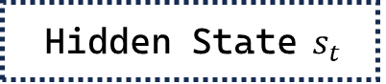
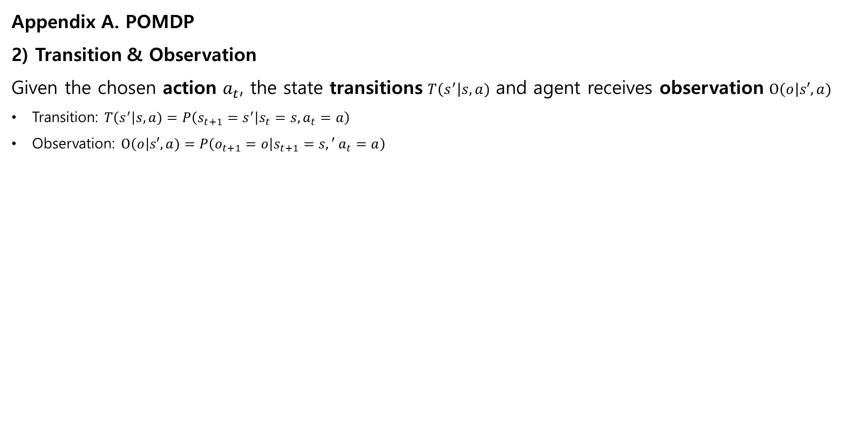

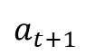

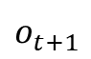
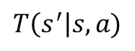
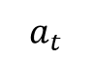
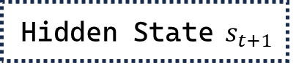
Cybersecurity Red-Team Agent with (Deep) Reinforcement Learning
Appendix A. POMDP
2) Transition & Observation
Given the chosen action $a_{t}$, the state transitions $T\left(s^{′}\right|s, a)$ and agent receives observation $O\left(o\right|s′, a)$
Transition: $T\left(s^{′}\right|s, a)=P\left(s_{t+1}=s^{′} | s_{t}=s, a_{t}=a\right)$
Observation: $O\left(o\right|s′, a)=P\left(o_{t+1}=o | s_{t+1}=s,′ a_{t}=a\right)$
Environment
Agent
$$o_{t}$$
Hidden State $s_{t}$
Update Belief and
Choose action
$$a_{t}$$
$$T\left(s^{′}\right|s, a)$$
Hidden State $s_{t+1}$
$$o_{t+1}$$
Update Belief and
Choose action
$$a_{t+1}$$
$$o_{t+2}$$
Update Belief and
Choose action
Notes:
When agent do action, the hidden state transitions and agent receives observation from environment.

Slide 20
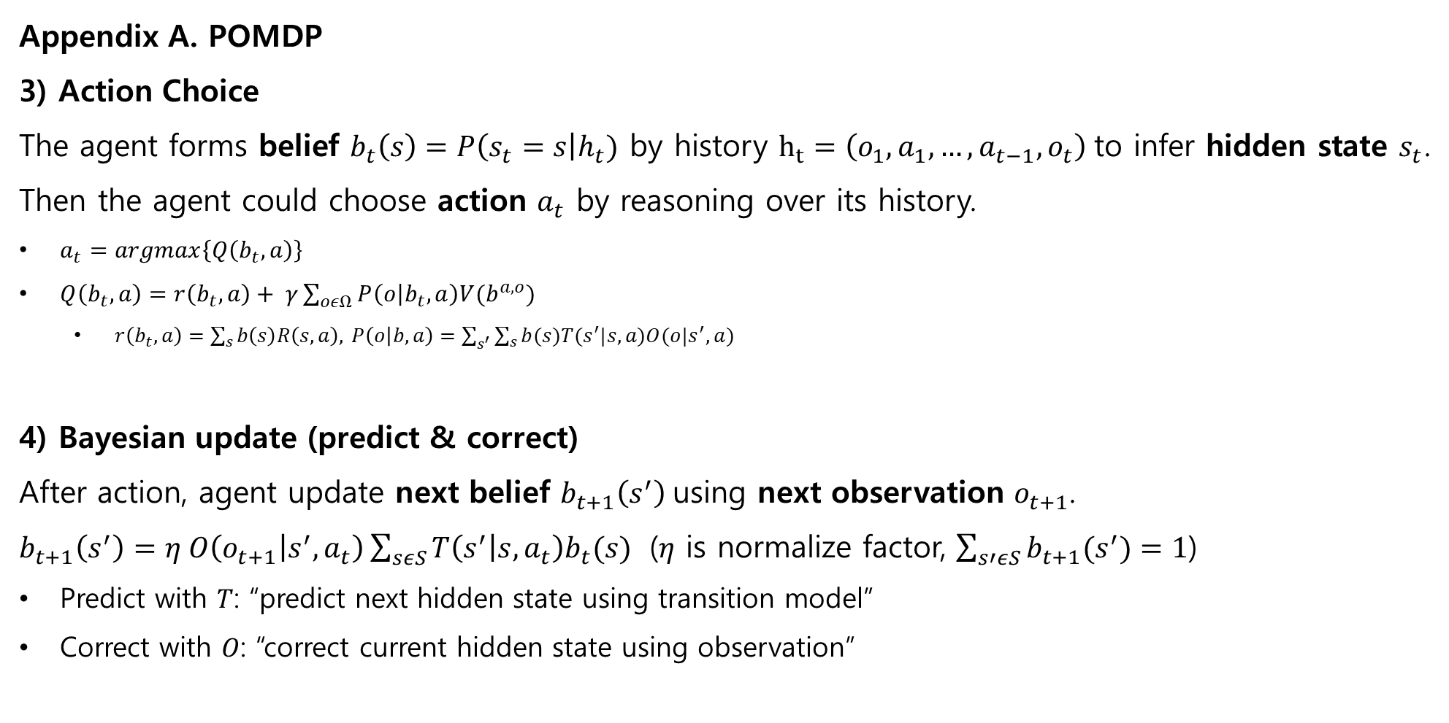
Cybersecurity Red-Team Agent with (Deep) Reinforcement Learning
Appendix A. POMDP
3) Action Choice
The agent forms belief $b_{t}\left(s\right)=P\left(s_{t}=s\right|h_{t})$ by history $h_{t}=\left(o_{1}, a_{1},…, a_{t−1},o_{t}\right)$to infer hidden state $s_{t}$. Then the agent could choose action $a_{t}$ by reasoning over its history.
$a_{t}=argmax\left\{Q\left(b_{t},a\right)\right\}$
$Q\left(b_{t},a\right)=r\left(b_{t},a\right)+ γ\sum_{oεΩ}{P\left(o | b_{t},a\right)V(b^{a, o})}$
$r\left(b_{t}, a\right)=\sum_{s}{b\left(s\right)R\left(s,a\right), }P\left(o | b,a\right)=\sum_{s^{′}}{\sum_{s}{b(s)T(s^{′}|s,a)O(o|s^{′},a)}}$
4) Bayesian update (predict & correct)
After action, agent update next belief $b_{t+1}\left(s^{′}\right)$using next observation $o_{t+1}$.
$b_{t+1}\left(s^{′}\right)=η O\left(o_{t+1} | s^{′},a_{t}\right)\sum_{sεS}{T\left(s^{′} | s,a_{t}\right)b_{t}(s)}$ ($η$ is normalize factor, $\sum_{s′εS}{b_{t+1}(s^{′})}=1$)
Predict with 𝑇: “predict next hidden state using transition model”
Correct with 𝑂: “correct current hidden state using observation”
Notes:
The agent forms belief by history to infer hidden state.
Then the agent could choose action by reasoning over its history.
After action, agent update next belief using next observation.
POMDP model agent repeat 3)-4) until end condition.

Slide 21
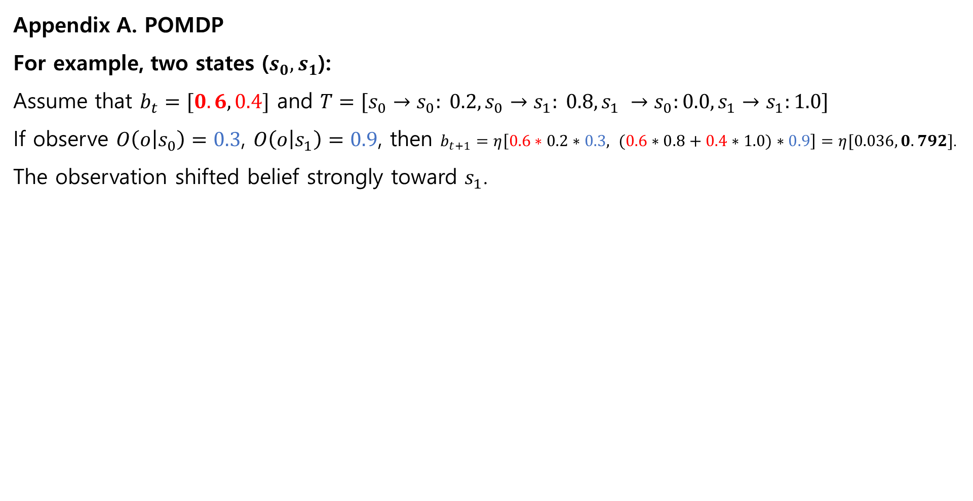
Cybersecurity Red-Team Agent with (Deep) Reinforcement Learning
Appendix A. POMDP
For example, two states ($s_{0}, s_{1}$):
Assume that $b_{t}=[0.6, 0.4]$​ and $T=[s_{0}→s_{0}: 0.2,s_{0}→s_{1}: 0.8,s_{1} →s_{0}:0.0, s_{1}→s_{1}:1.0]$
If observe $O\left(o | s_{0}\right)=0.3$, $O\left(o | s_{1}\right)=0.9$, then $b_{t+1}=η\left[0.6∗0.2∗0.3, (0.6∗0.8+0.4∗1.0)∗0.9\right]=η[0.036, 0.792]$.
The observation shifted belief strongly toward $s_{1}$.

